Slide 1
Preheater profile Introduction and Solution
Technical Development Program
SPREAD 2016
Side bars indicate that this is a solution slide which should not be shown to the participants beforehand

Slide 2
Objectives / Scope of a preheater check tool
Objectives
Show efficiency of the preheater (Δp, ΔT)
Quantify reserves through velocities within the preheater (cyclone inlet, dip tube)
Quantify amount of false air intake in preheater tower
Benchmark with typical range of preheater profile
Scope
Gas and meal temperature profile across preheater
Pressure profile of the preheater
Oxygen and CO profile of the preheater
Check of velocities through the preheater

Slide 3
Preheater check – Step 1: Preliminary work
Dimensions required to be filled in the “Geometry” sheet
Drawings required to check gas velocities:
Dip tube and riser duct of each stage
Tertiary air duct (inside lining)
Calciner diameter inside lining or equivalent diameter if different shape.
Kiln diameter inside lining.
Drawings required to check gas residence time in calciner:
Entire calciner: Active volume = volume inside refractory between first fuel feed point and inlet of bottom cyclone

Slide 4
Preheater check – Step 2: Inspection
Inspection of preheater before measurement
Check-list during inspection (for each stage):
Is there a splash box?
Is there a flap in meal duct?
Is the meal flap working?
Location of measurement points:
Open, and check if still free (no lining).
Check distance from splash box (if measurement port in riser duct)

Slide 5
Preheater check – Step 3: Measurements
Measurements required
Temperature
Pressure
Oxygen and CO
Fuel rate
Kiln feed rate
Kiln feed moisture
Location of measurements:
Kiln inlet
Tertiary air
Calciner (including orifice)
Outlet of each stage
Notes:
Nbr of measurment points for calciner: depending on calciner size.
Probable high fluctuations of temperature, oxygen and CO mesurement in calciner.

Slide 6
Preheater check – Step 4: Fill out the tool
The gas flow calculation uses the same formula as in your PPE reference guide.
V min from combustion of fuel
CO2 from raw material
Excess air
Water vapor from RM (top stage)

Slide 7
Preheater check tool – online presentation
New standard tool (can select number of strings, number of stages, with ILC or/and SLC, bypass, etc…)
It is composed of 4 sheets: Geometry, Measurements, Calculations and Evaluation.
Note: In case of precombustion chamber use in-line configuration. For residence time, if a more accurate calculation is required, do a separate calculation

Slide 8
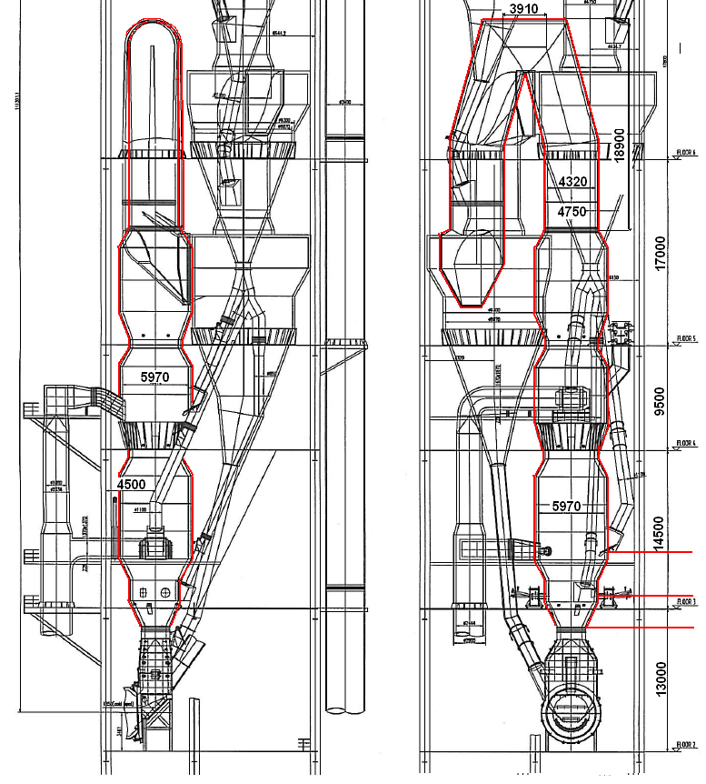
Task 1: Estimate Active volume of Calciner
Determine the boundaries of the calciner active volume.
Select the correct active volume of calciner to enter in tool (length of calciner goose neck part is 39.9m)
- 940 m3
- 1‘370 m3
- 1‘620 m3
30300

Slide 9
Task 1 : Solution
Active volume = volume inside refractory between first fuel feed point and inlet of bottom cyclone
Estimation of calciner active volume
Estimation Goose neck = 39.9 [m] x 14.66 [m2] = 585 m3
Estimation main vessel = 30.3 [m] x 28 [m2] = 848 m3
Total estimated = 1433 m3 (Correct EXACT VOLUME is 1370 m3)

Slide 10
Task 2: Fill out missing measurements
Choose the most likely correct value between CCR and measurement and propose root cause of the difference.
Static Pressure at stage 4 outlet:
CCR reading: -29 mbar
Measurement: -24 mbar (measured in cyclone roof because no measuring port free in riser duct).
Meal temperature (stage 5)
CCR reading: 860°C
Measurement: 900°C
Gas temperature (stage 3)
CCR reading: 650°C
Measurement: 590°C

Slide 11
Pressure of Stage 4
CCR reading most likely.
Pressure measured at cyclone roof: Dip tube is responsible of about 2/3 of pressure drop over one stage.
Possible other root causes:
Mechanical failure: Dip tube has fallen? (most likely not here due to pressure profile of above stages)
Coating in riser duct?
Unstable kiln operation?

Slide 12
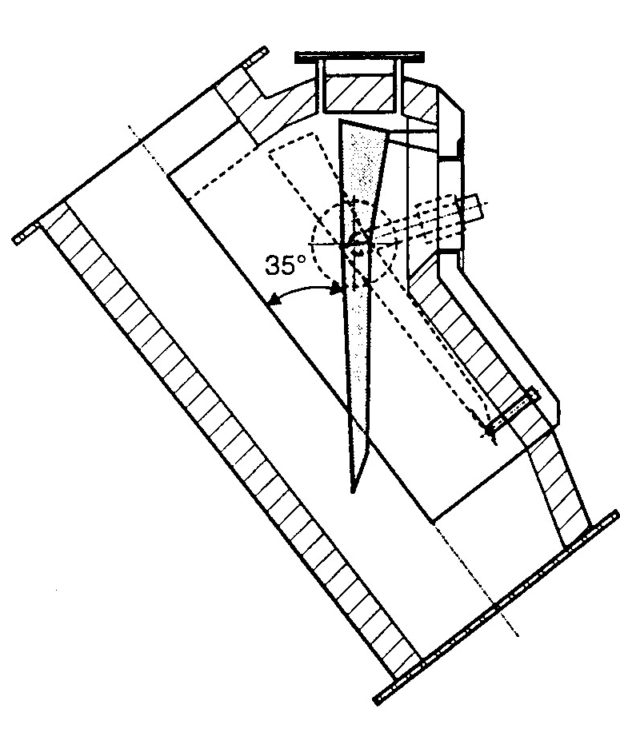
Meal temperature of Stage 5
CCR reading
T_{meal} should be lower than T_{gas}
Probable root causes:
Meal flap of Stage 5 is not working (see also in Geometry sheet)
Wrong measurement (it is usually a difficult measurement)
Possible causes of Meal flap failure:
harsh conditions at bottom stage: high temperature / sulfur and chlorine cycles, (especially with some alternative fuels)
Missing flap consequences:
Gas bypasses stage
Bad heat exchange
Volatiles condense in the duct
Cloggings

Slide 13
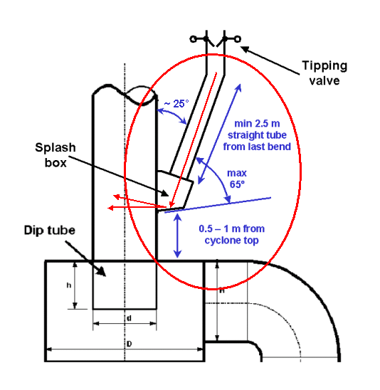
Gas temperature of Stage 3
Probable root causes:
Part of meal is falling down from riser duct?
Measurement to close to splash box?
Unstable kiln operation?
Proposed measure:
Other location for measurement (gas temperatures in riser duct before heat exchange and at cyclone roof should be the same)

Slide 14
Task 3: Oxygen and calcination degree
Enter different oxygen content (kiln inlet, preheater exit) and observe impact on gas flow (ex: How much % increase of gas flow for +1%O2?)
Enter different calcination degree and observe impact on gas flow at kiln inlet.

Slide 15
Impact of excess air on gas flow calculation
1% O2 increase at kiln inlet results in ~5% more gas flow

Slide 16
Impact of excess air on gas flow calculation
1% O2 increase PH exit results in ~5.5% more gas flow

Slide 17
Apparent and true calcination degree

Slide 18
Impact of calcination degree on gas flow calculation
5% calcination degree decrease (at kiln inlet) results in <3% more gas flow (calcination degree = CO₂ already emitted downstream)

Slide 19
Task 4: False air and Preheater efficiency
Quantify amount of false air
Discuss preheater efficiency

Slide 20
Task 4: Solution
%V_{FA}= (O₂ _{out} – O₂ _{in}) / (21 - O₂ _{out}) x 100
Approx 5.6% False air.
Lowest stage ΔO₂ = 0.4, other stages ΔO₂ = 0.2 Preheater tight → No room for false air reduction.
Gas velocities, pressure drop are ok (typical range)
Overall efficiency: Relatively good.

Slide 21
Tips - Preheater check tool
Compare measurement value with CCR reading (important to note the time of measurement!)
CO inputs: from fuels or from raw material (%CO increase or decrease?)
Compare results of preheater check with historical preheater profiles (track if any trend)
Meal temperature measurement only possible if safe location is provided (often not possible)
Check stable kiln operation with CCR during measurement period.
Notes:
CO from fuels (reduced burning conditions or incomplete combustion) -> Observe dilution over preheater (%CO decrease from stage to stage through false air)
CO from raw materials (from TOC) -> Observe increase in top stages (%CO increase)

